Slide 1
How I Code
with my
Gaming Mouse

Slide 2
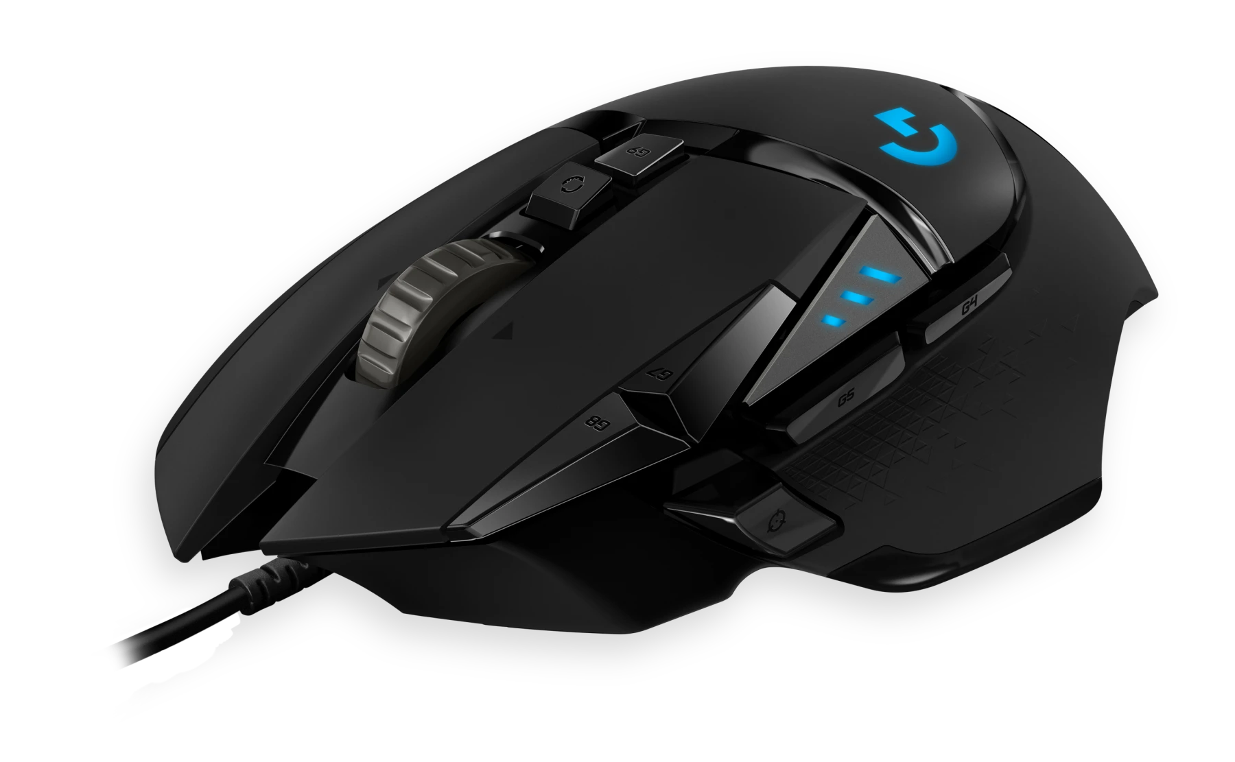
Weapon of Choice
Logitech G502 Hero
Hyper-Fast scroll wheel
High DPI & Polling Rate
11 (20) programmable buttons

Slide 3
Hyper-Fast scroll wheel
Reading and navigating web pages faster
Reading through documentation faster
Reading code faster
Less movement

Slide 4
High DPI & Polling Rate
Smoother more precise control
Able to move across multiple monitors in a single swipe
Less movement

Slide 5
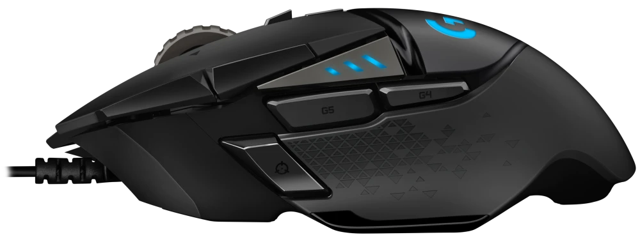
Level 1 Programmable Buttons
Copy
Paste
Double click = word
Triple click = line/paragraph
Four clicks = all*
*in vscode

Slide 6
Level 1 Programmable Buttons
Ctrl + c
Ctrl + v
scroll = zoom
Browser link = open in new tab
VScode
Go to definition
Open file path
Open url
*in vscode

Slide 7
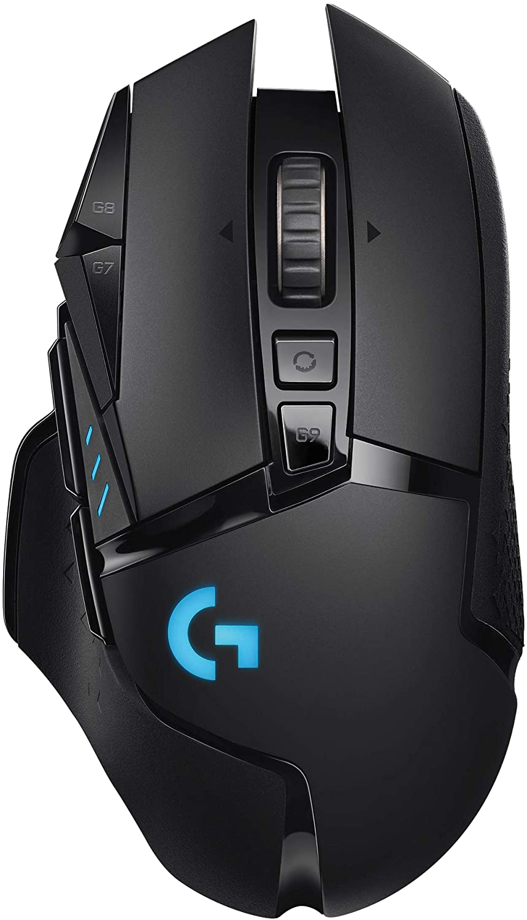
Level 2 Level Programmable Buttons
Backspace - Character behind
Delete - Character ahead
Backspace
Delete

Slide 8
Level 2 Programmable Buttons
Last 25 things you copied
Text
Images
Files
Clipboard
( win + v )

Slide 9
Level 2 Programmable Buttons
Volume down
Volume up

Slide 10
Level 3 Programmable Buttons
Holding G-shift adds 10 more buttons
G-shift

Slide 11
Level 3 Programmable Buttons
Select next occurrence
Comment line(s)
undo
redo
Indent forward
Duplicate line
Restart VScode
Indent backward
Save all files

Slide 12
Level 4 Gestures
https://www.strokesplus.net/

Slide 13
How I Code
with my
Gaming Mouse

